Slide 1

Course Management API: Student Registration and CRUD
This presentation outlines the development of a comprehensive Course Management API designed to streamline student registration and provide robust CRUD functionality for courses and students.

Slide 2

Introduction to the Course Management System
1
Course Information
2
Student Enrollment
3
Administrative Management
The system provides a comprehensive overview of available courses, including details about instructors, schedules, and prerequisites.
Students can easily browse and register for courses that meet their academic interests and requirements.
Administrators have access to manage courses, student enrollments, and other system settings.

Slide 3
API Design: Defining Courses and Students
Courses
Students
Course ID
Student ID
Course Name
First Name
Instructor
Last Name
Description
Email
Prerequisites
Password

Slide 4





Implementing CRUD Operations for Courses
Create Course
Create a new course by providing all required information, including course name, instructor, description, and prerequisites.
Read Course
Retrieve details about a specific course, including its ID, name, instructor, and associated data.
Update Course
Modify existing course data, such as updating the instructor, description, or prerequisites.
Delete Course
Remove a course from the system, ensuring data integrity and preventing accidental deletions.

Slide 5
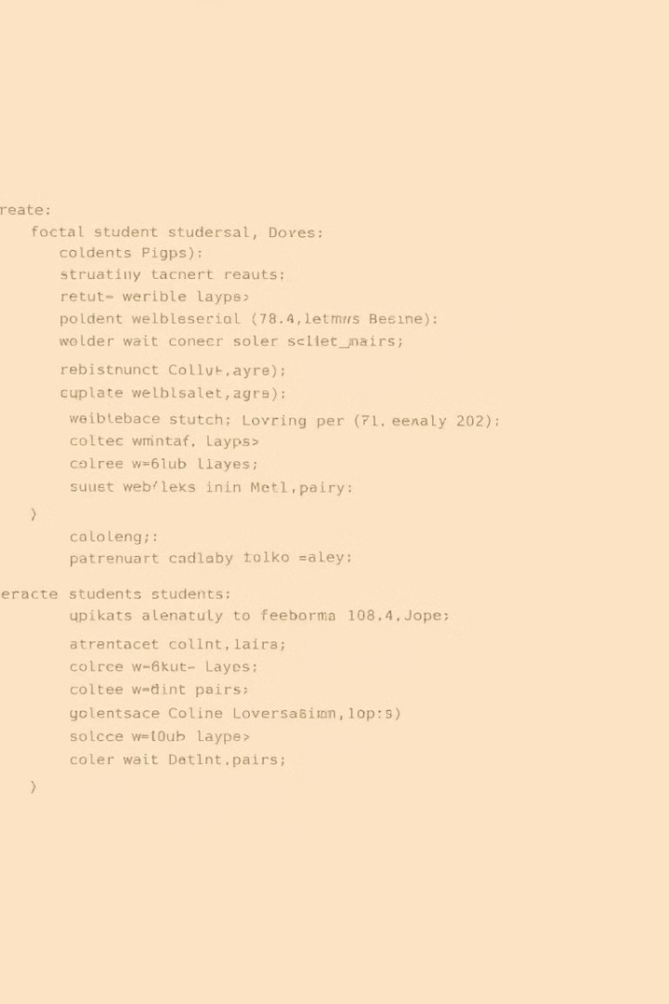
Implementing CRUD Operations for Students
Create Student
Read Student
Register a new student by providing their name, email address, and password. The system should securely store and validate user data.
Retrieve details about a specific student, including their ID, name, email, and enrollment history.
Update Student
Delete Student
Modify student information, such as updating their name, email address, or password. Implement appropriate security measures.
Remove a student from the system. Implement proper deletion procedures to ensure data integrity and prevent unauthorized access.

Slide 6

Authentication and Authorization
1
User Authentication
Implement secure user authentication using mechanisms like JWT (JSON Web Token) to verify user identities and ensure authorized access to the API.
2
Role-Based Authorization
Define different user roles, such as student, instructor, and administrator, with specific permissions based on their responsibilities.
3
Access Control
Enforce access control rules to restrict unauthorized users from accessing sensitive data or performing actions they are not authorized to perform.

Slide 7




Error Handling and Edge Cases
Error Messages
Provide informative error messages to help developers identify and resolve issues promptly.
Logging
Implement robust logging mechanisms to capture errors, exceptions, and other critical events for debugging and analysis.
Edge Cases
Identify and handle edge cases, such as invalid input, concurrency conflicts, and data validation errors to ensure API stability.

Slide 8
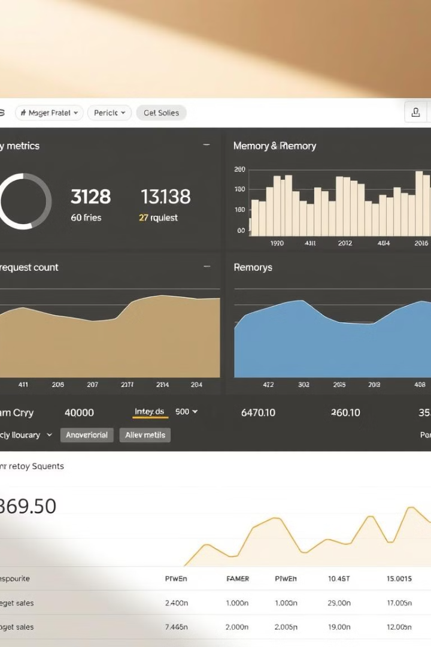
Deployment and Monitoring
Deployment Strategy
Containerization using Docker or Kubernetes for easy deployment and scaling.
Monitoring Tools
Integrate monitoring tools like Prometheus and Grafana to track API performance, availability, and error rates.
Logging and Analytics
Collect and analyze logs to identify potential performance bottlenecks, security threats, and user behavior patterns.

Slide 9

Conclusion and Next Steps
The Course Management API provides a robust and scalable solution for managing courses and student registrations.
Future improvements may include features such as course scheduling, online payment integration, and real-time notifications.

